Slide 1
Mountain Car
CS6890 - Agnibh Dasgupta (A02292865)

Slide 2
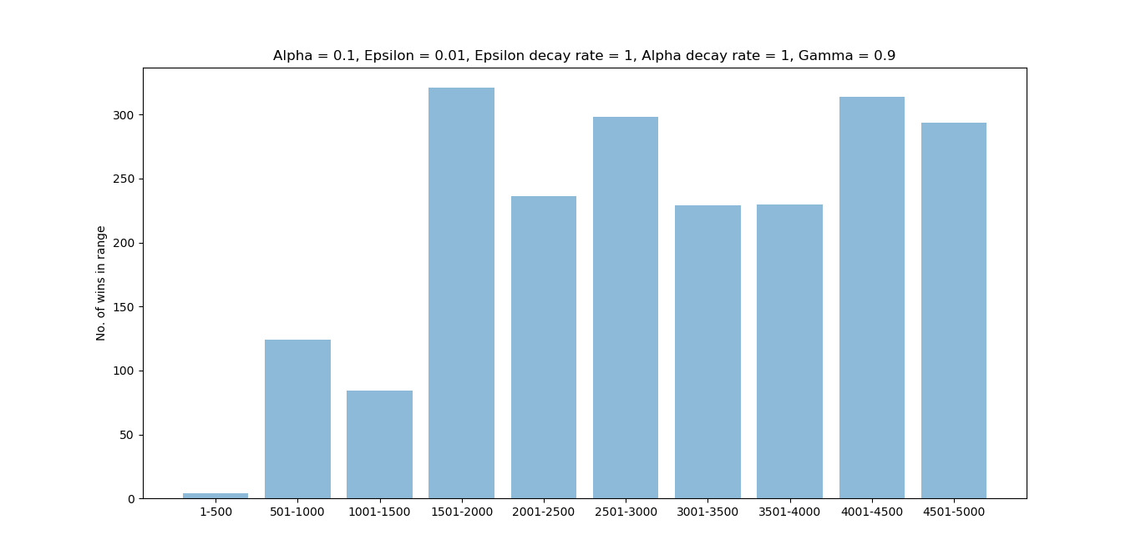

Slide 3
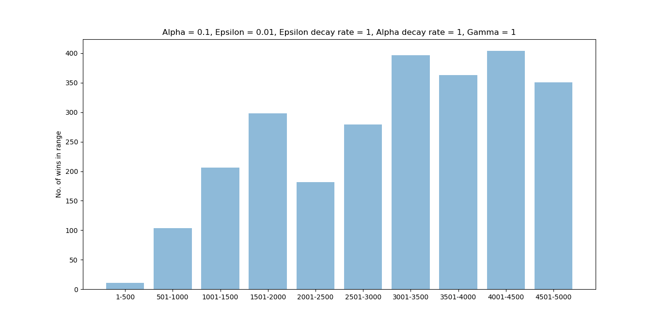

Slide 4
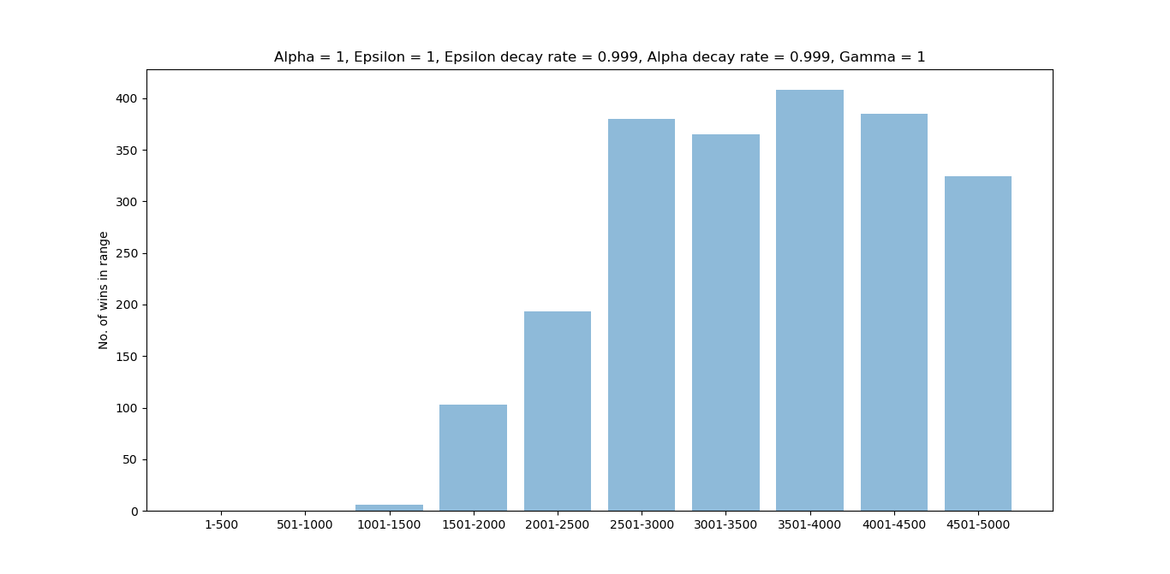

Slide 5
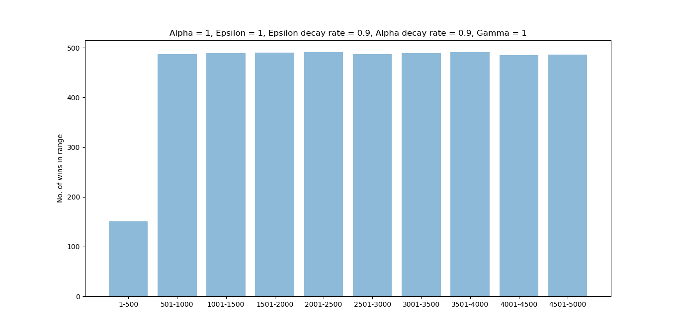

Slide 6
Notables
Epsilon decay rate faster than 0.8 is bad. Doesn't explore enough in the first episodes to exploit the last episodes and win more consistently. (initial values = 1)
Epsilon decay rate faster than 0.9 is inconsistent. Sometimes learns, sometimes doesn't. (initial values = 1)
Epsilon decay rate slower than 0.9 is slow to learn. Doesn't decay the exploration rate fast enough, 0.9 performs better on average. (initial values = 1)
Initial Epsilon below 0.8 is inconsistent. Doesn't explore enough sometimes in the first episodes to greedify the last episodes to win. Sometimes does. (Decay rates = 0.9)
Epsilon and alpha high at start (close to 1) does work better than lower values, given we decay them. (Decay rates = 0.9)
Overall, decay rate of 0.9 (alpha and epsilon) and initial value of 1 works better than other cases. Also works better than static values. Discounting sucks.

